Slide 1
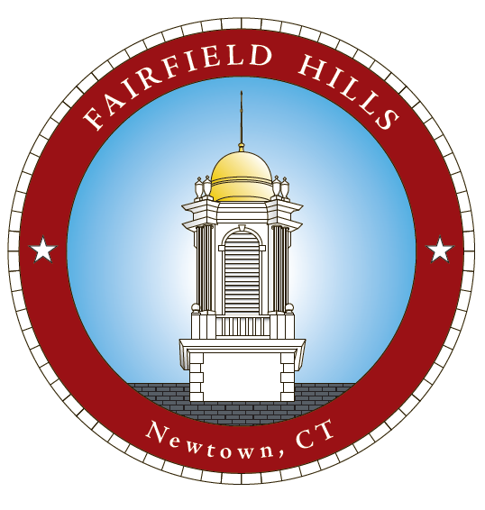
Fairfield Hills Campus - Meet Potential Developers -
Community Conversation #4 – October 5, 2020

Slide 2
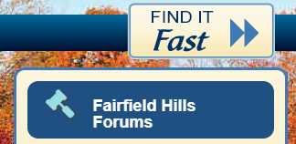
Past Community Conversations -
Presentations and videos of the meetings are available on Newtown-CT.gov.
Click on Fairfield Hills Forums in the right menu.

Slide 3
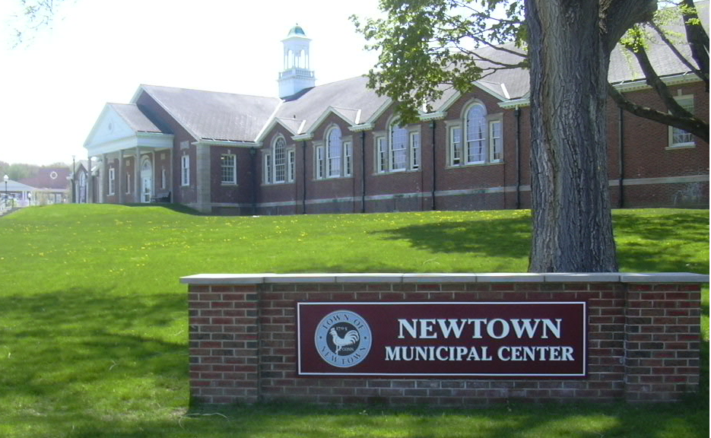
Process -
Referendum:
Voters decide whether to include mixed use housing as an allowed use.
Board of Selectmen:
Approve the Fairfield Hills Master Plan Review Committee (2018) Recommendations
Pass a resolution authorizing the Land Use agency to apply to the Planning and Zoning Commission for an amendment to the FHAR adding Mixed Use Housing as a Permitted Use.
Planning & Zoning Commission:
Must approve mixed use housing as an approved use on the campus.
FHAR zone must be updated to include mixed use housing as an approved use.
Official Applications:
Developers will submit their official applications.
Applications will be reviewed by the Fairfield Hills Authority, the Board of Selectmen, and Planning & Zoning.

Slide 4
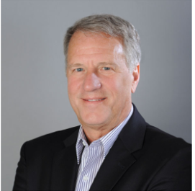
DakotaPartners.net

Slide 5
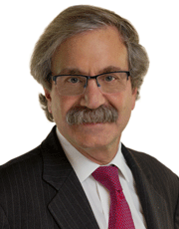
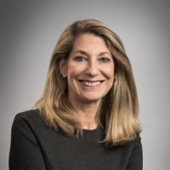
Lawrence H. Curtis
President and Managing Partner
Marla Curtis
The Architectural Team
WinnCompanies.com
Architecturalteam.com

Slide 6
