Slide 1
Newtown Police Department Facility Needs Assessment & Validation
The following presentation identifies the facts through 19 years of research to justify moving forward.
“Give us the tools and we will do the job”
- Winston Churchill
By Chief James Viadero and Lieutenant David Kullgren Updated 08/16/2018

Slide 2
19 Years of Research,
19 Years of Facts.
1999 Facility Assessment conducted by Kaestle Boos Assoc, Incorporated:
  In 1999 facility had an estimated 700,000 worth of improvements recommended in categories of Urgent, highly recommended and lowest priority. In todays dollars that is over $1,000,000.00, not to mentioned what has been added to this list since.
2008 Facility Needs Assessment conducted by Jacunski Humes Architects, LLC. :
  The current facility is inadequate for the Town’s current needs and by far will not suffice for the future needs of the department and thus the needs of the Town.
  Based on a 2009 Study conducted by Lt. Kullgren of the current facility and property:
    The current property and facility with respect to size, zoning regulations, building codes and space needs are inadequate. Hence renovating the current facility is not an option and would be cost prohibitive.
  2015 Municipal Buildings Strategic Plan Advisory Committee (DRA Architects)
    Tasked with reviewing a number of Town buildings to include the Police Department.
    Oct 2015 meeting, “Motion: Jim Filan motioned to recommend to the Board of Selectman that Town Hall South not be renovated for the purposes of the Police Department based on the numbers given at today’s meeting. Kathy Hamilton seconded. The motion was approved unanimously. “
    The Committee further recommended renovating other Town buildings would be cost prohibitive, building from scratch is the smartest and most cost-effective approach.
By Lieutenant David Kullgren

Slide 3
Why a New Facility is Needed
Since 1999 the town has conducted and paid for three space/facility need assessments; 1999, 2008 and 2015. All three of these studies resulted in the same conclusion. That the current facility is inadequate for current staffing and space needs, not to mention future growth of the agency and the community.
"We can't solve problems by using the same kind of thinking we used when we created them"
-Albert Einstein
By Lieutenant David Kullgren

Slide 4
Further Validation
Space deficiencies; restrooms, training, evidence processing, offices, storage, equipment, etc.
Fire, electrical and ADA codes, HVAC and Information technology deficiencies, which do not meet current standards.
Parking deficiencies.
Current facility and property are inadequate for upgrade or expansion.
Security and safety deficiencies.
State and Federal mandates continue to stress the existing agency and facility limitations.
Current facility is in need of major repairs; dilapidated siding, leaks, HVAC, septic, ADA compliance, etc.
Our community needs a place for law enforcement and our residents to meet, train and network together.
By Chief Viadero and Lieutenant David Kullgren

Slide 5
Current CIP Allocations
Fiscal Year 2017/2018:
  $500 thousand, design & engineering of a new facility
Fiscal Year 2018/2019:
  $5 million, to be detailed in Municipal Facility Plan
Fiscal Year 2019/2020
  $5 million, to be detailed in Municipal Facility Plan
By Chief Viadero

Slide 6
Talking Points
Will a new facility house the Emergency Communication Center?
  Yes, current regionalization legislation has failed year after year.
What Town owned building will be consolidated or closed?
  None
Where would a new facility be located?
  Fairfield Hills?
What are the square footage requirements?
  Cost to construct? $13-15 Million (2015 dollars)
  Will a range be a component of the new facility? Yes, as range availability is limited statewide.
By Chief Viadero

Slide 7
Areas of Extreme Concern
Sharing space with three other Town Departments.
  Severely hampers public access to the facility and overall security
  Limited parking for staff and residents
  Limited public meeting area for staff and residents
  Lobby security concerns for our residents
Lack of Adequate Offices & Circular Accommodations
  Restrooms
  Breakrooms
  Prisoner Booking & Lockup
  Administrative offices
  Locker rooms
  Storage
By Chief Viadero

Slide 8
Areas of Extreme Concern
(continued)
Server Room
  All Town servers pass through the Police Department
  Server room is overloaded today
Professionalism
  Morale
  Esprit de corps
  What type of image does the current facility project to the residents?
  Current facility limits our agency to function optimally
  Community meeting/presentation
  Department training needs
  21st Century Policing & technology demands
By Chief Viadero

Slide 9
Comparison of the Newtown PD to Wethersfield PD & Farmington PD
This comparison was done in 2009 after the second space needs study was performed. Now 8 years later and a third study, we are still in the same position.
Wethersfield PD
  2003, built
  47 Sworn Officers
  Population 27,000
Farmington PD
  2002, built
  44 Sworn Officers
  Population 25,500
Newtown PD
  1980, converted into a police department.
  The current police department facility is an old tractor barn which was converted in 1980 (over 37 years ago) to be used as a police department. At that time there were 25 sworn officers, 3 support staff. At that time the dispatch staff were not under the same roof as they are now.
  2016, we have 45 sworn officers, 5 support staff, 13 dispatch staff. In 37 years the staff has more than doubled occupying the same building.
  Population 28,000
NOTE: Photographs in the following presentation are identified by;
  BLACK outlined are of Newtown PD,
  RED outlined are of comparable departments, i.e. Farmington/Wethersfield.
By Lieutenant David Kullgren

Slide 10
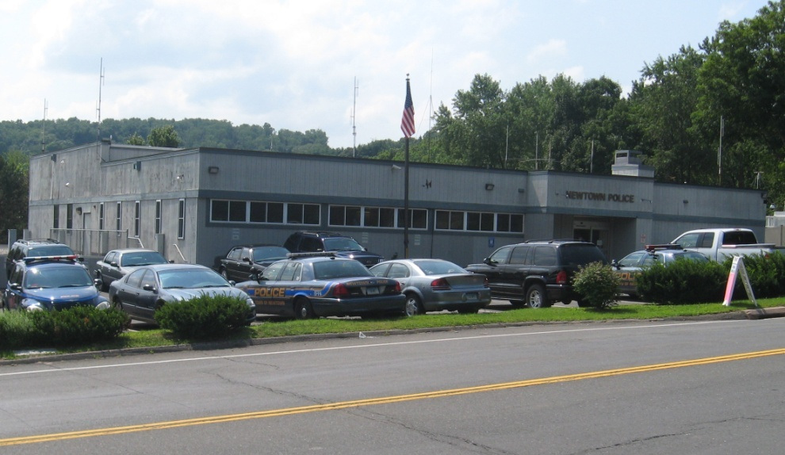
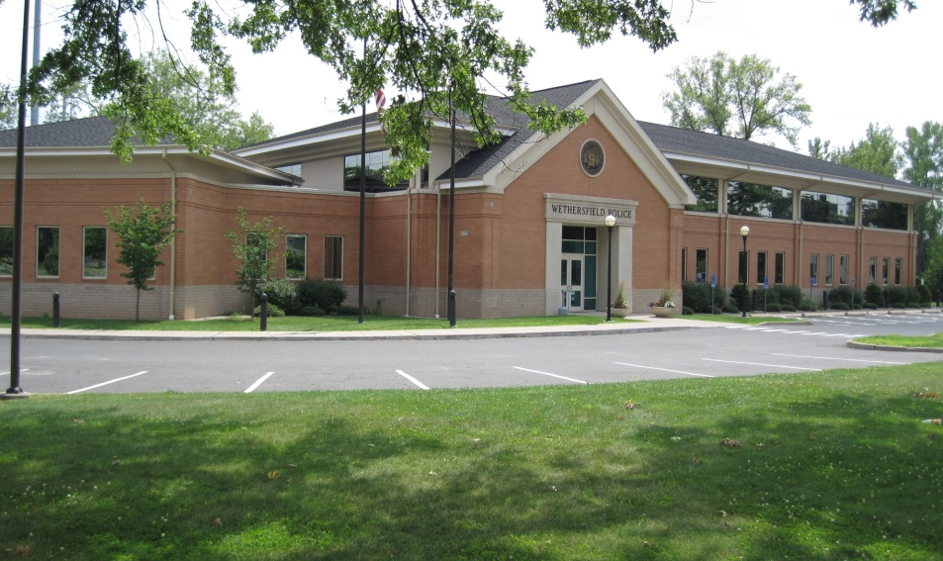
Building Exterior
Newtown PD
Wethersfield PD
Newtown PD currently 8,540 SQF
Inadequate facility to operate efficiently and securely
25,000 SQF
Professionalism
Pride
Energy efficient utilities
By Lieutenant David Kullgren

Slide 11
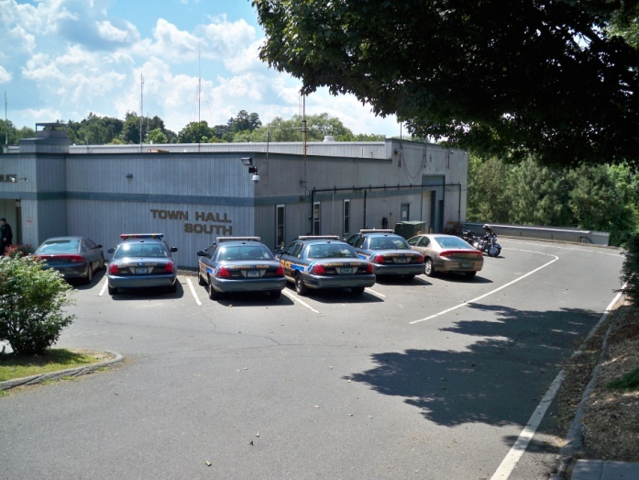
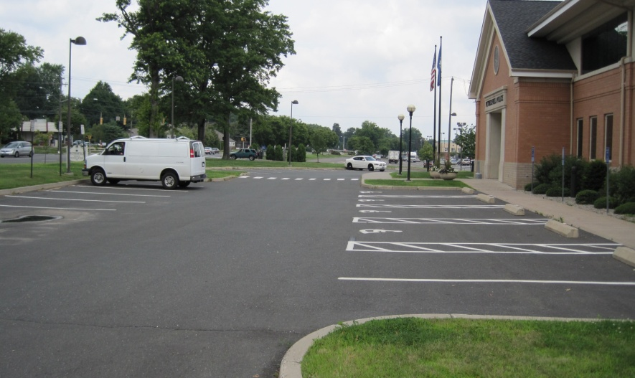
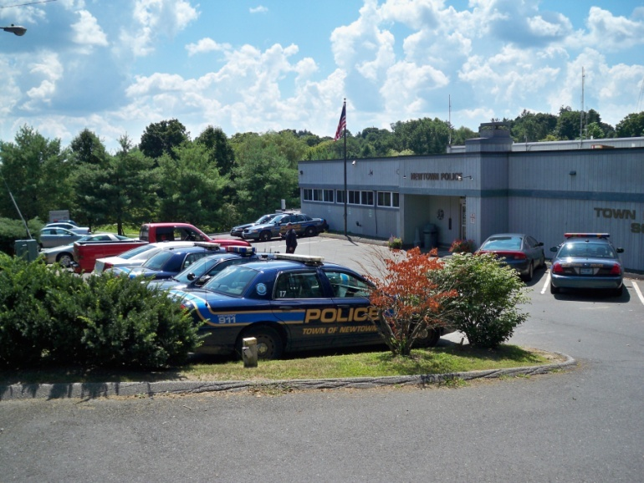
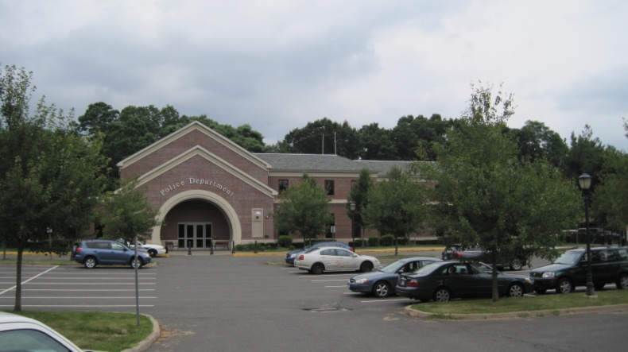
Parking, Front
Insufficient parking for staff, department vehicles and visitors.
No secure parking for department vehicles.
Newtown PD
Farmington PD
By Lieutenant David Kullgren

Slide 12
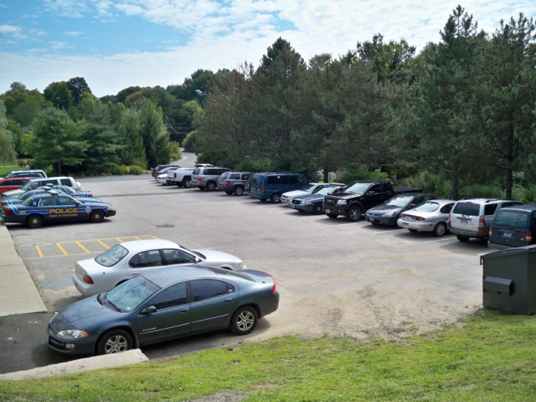
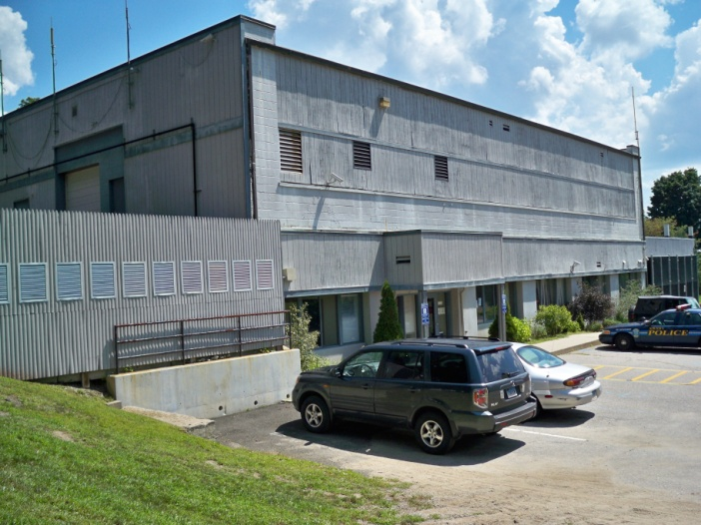
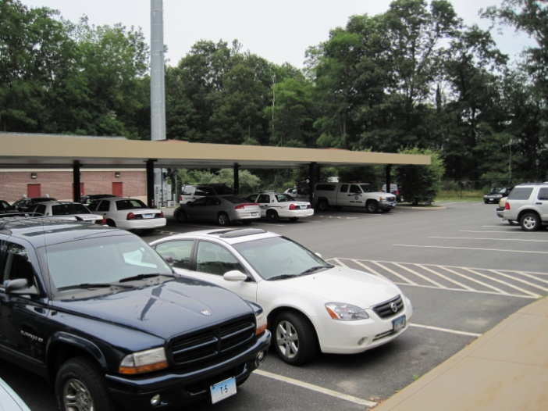
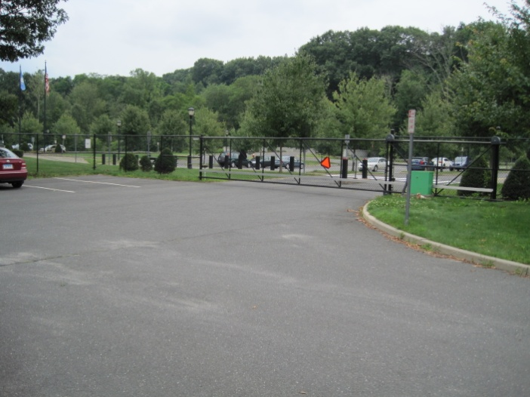
Parking, Rear
Inadequate parking for staff, department and visitor vehicles.
No covered parking for department vehicles.
No secure parking for department or staff vehicles.
Parking shared by three town departments.
Newtown PD
Farmington PD
By Lieutenant David Kullgren

Slide 13
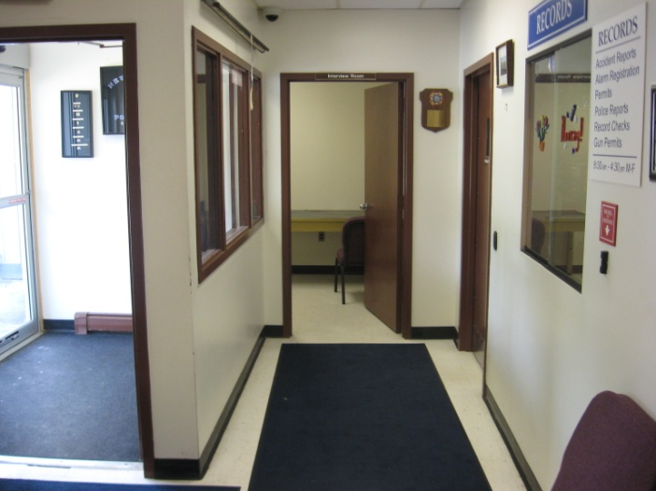
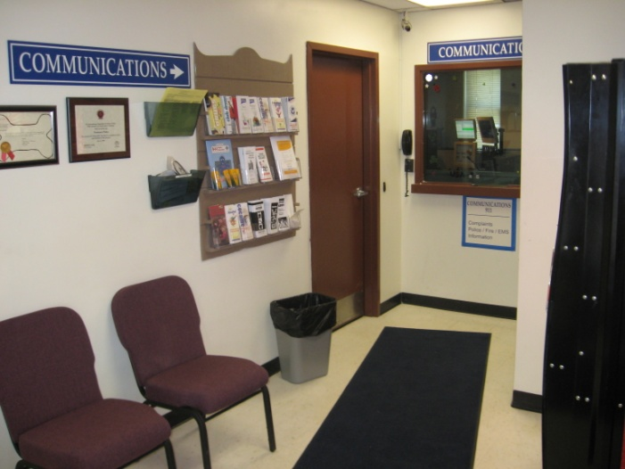
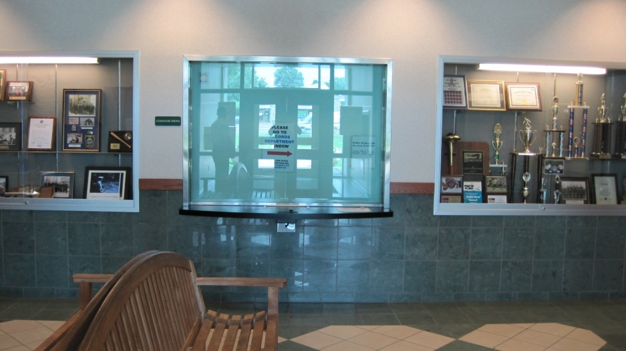
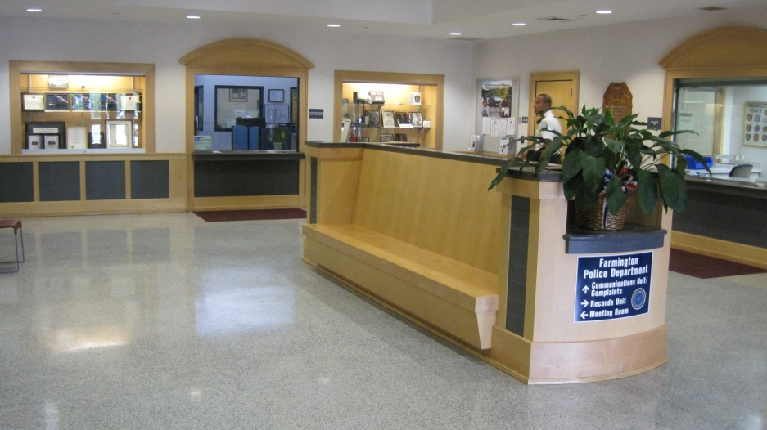
Lobby
Newtown PD
Newtown PD
Small Lobby used for dispatch, walk-in's, records and a adjacent interview room.
No confidentiality during interviews.
Only one interview at a time.
23’ x 10’ lobby which includes a bathroom
Wethersfield PD
Farmington PD
By Lieutenant David Kullgren

Slide 14
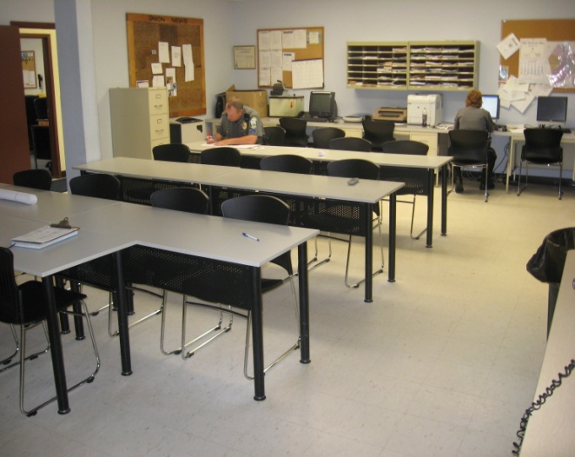
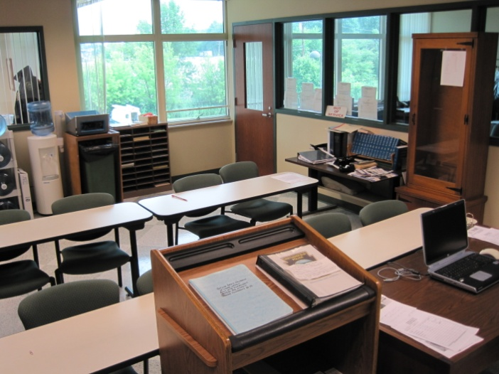
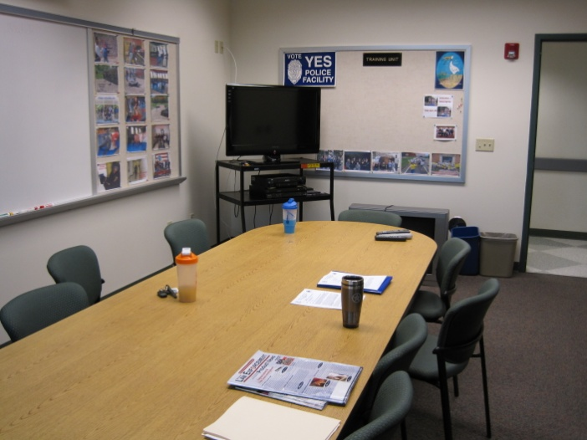
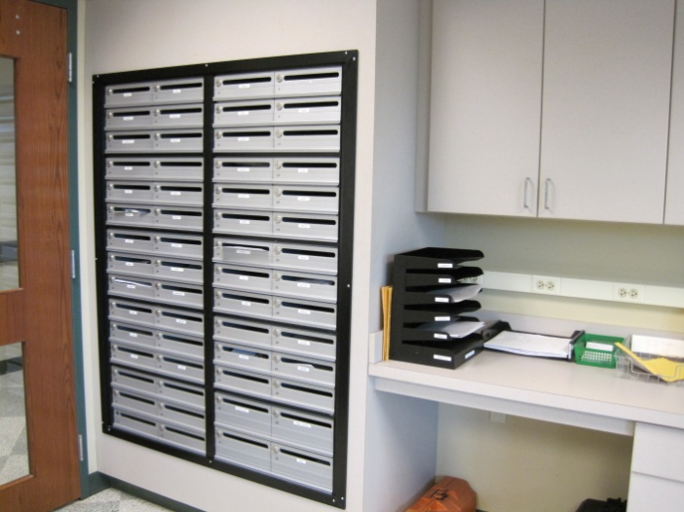
Training / Roll Call / Classroom
One room used for roll call, training, conferences, break room, evidence processing, firearms cleaning, meetings and visitors.
Also used to interview suspects, witnesses, victims and processing prisoners, lacking privacy and confidentiality.
Accessible to prisoner area.
20’ x 31’ room
Newtown PD
Wethersfield PD

Slide 15
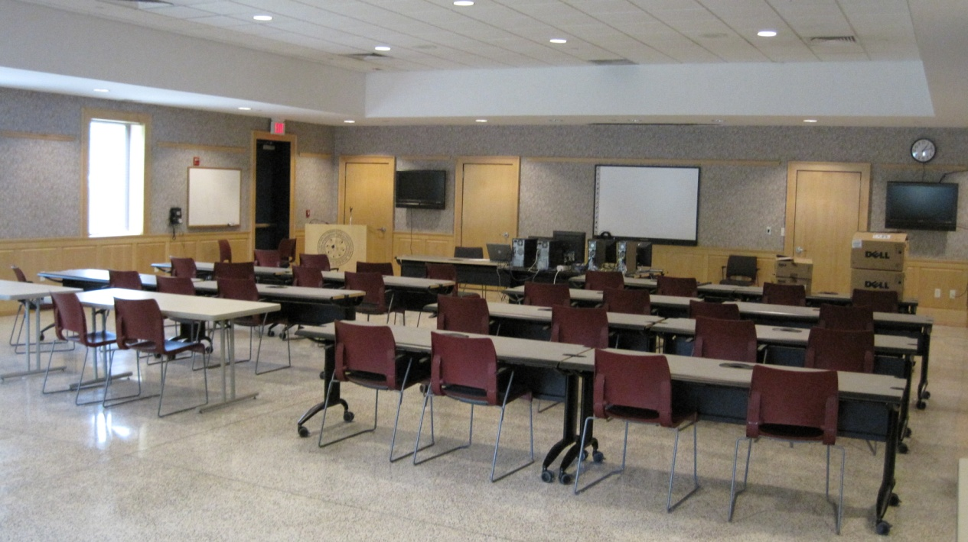
Community Room
Training Area
Press Room
Community use; promoting community relations.
Multipurpose meeting area; Town & Public.
Town wide benefit
Newtown does not have a multi purpose community meeting or training area.
Farmington PD

Slide 16
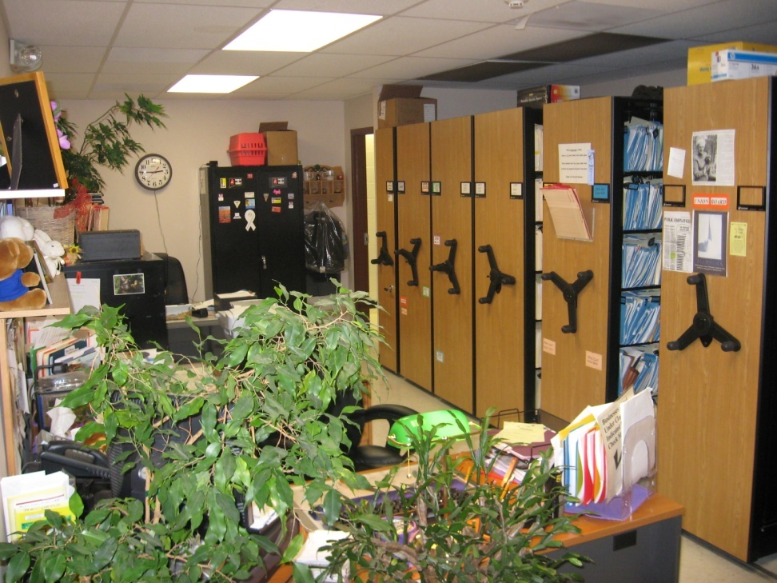
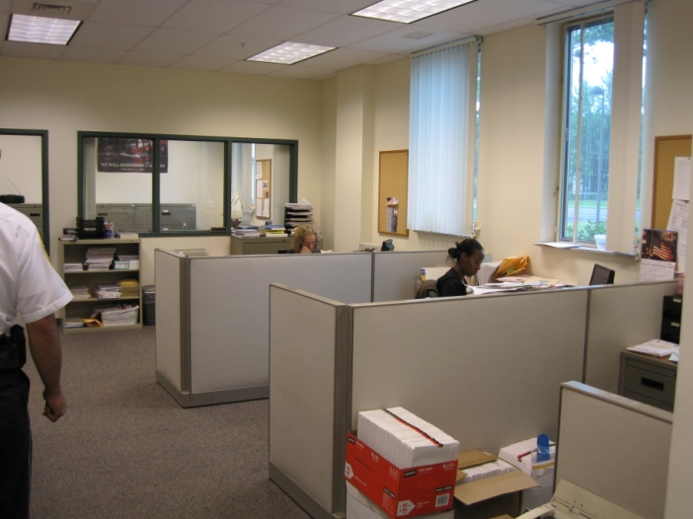
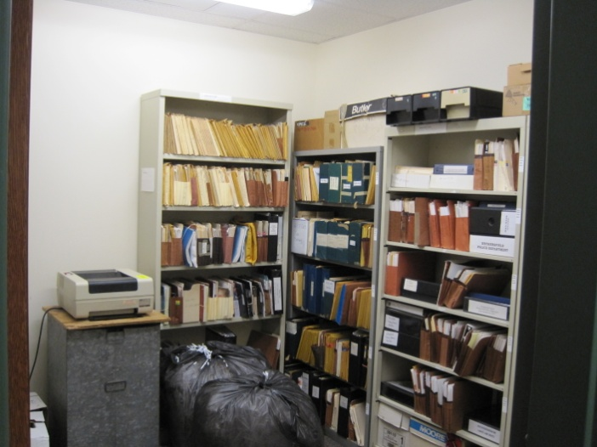
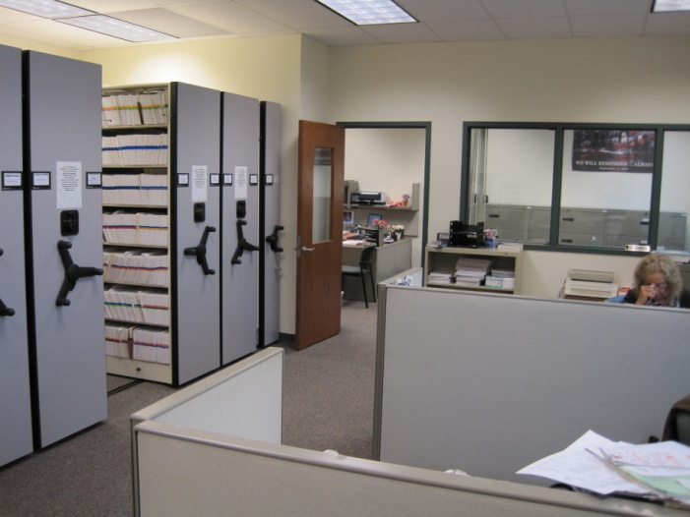
Records
Newtown PD
Insufficient; workspace, storage, archives.
Unsecure
Accessible to prisoner area.
10’ x 30’ room
Wethersfield PD
By Lieutenant David Kullgren

Slide 17
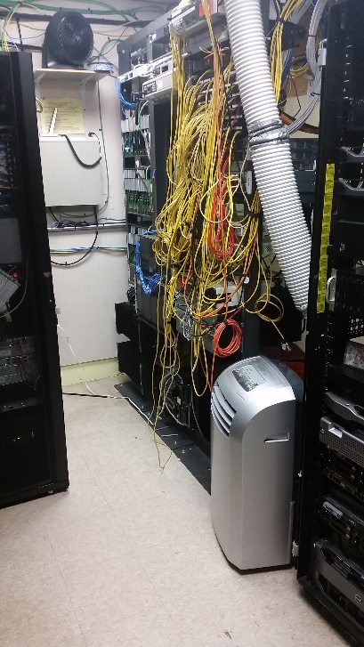
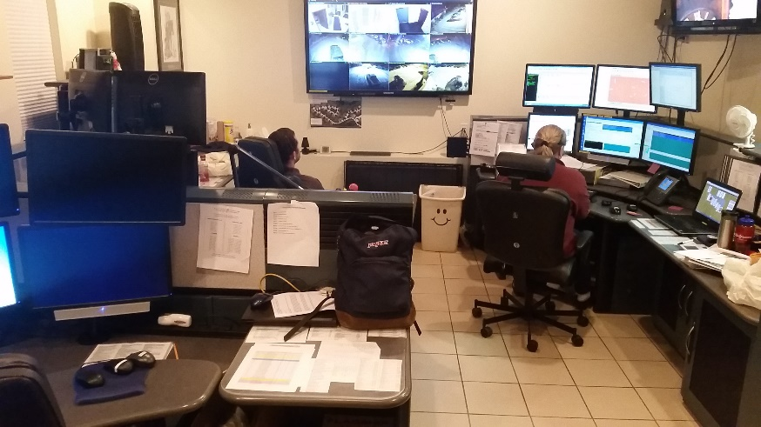
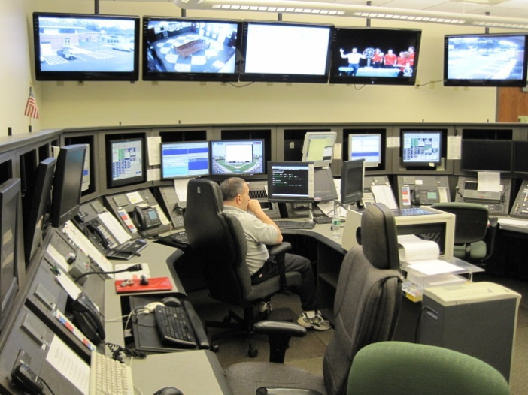
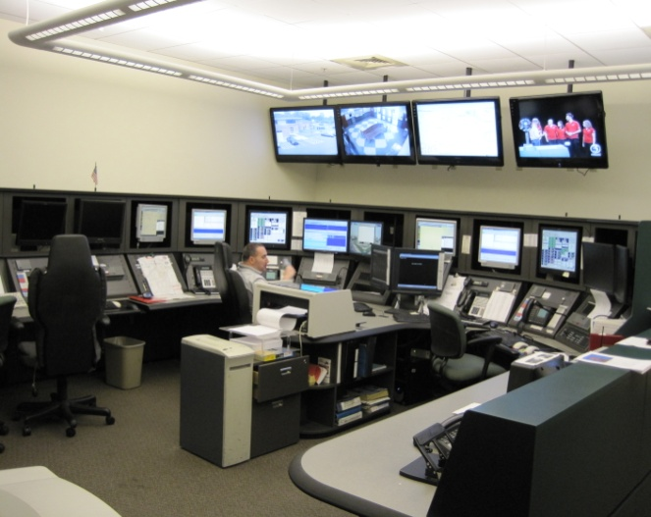
Communications / Server Room
Newtown PD
Electrical and computer infrastructure are out of room.
No room for growth to meet the Department’s and the Town’s needs.
Computer server room is overloaded.
A 28’ x 16’ room.
All Town Servers pass through this room.
Wethersfield PD
By Lieutenant David Kullgren

Slide 18
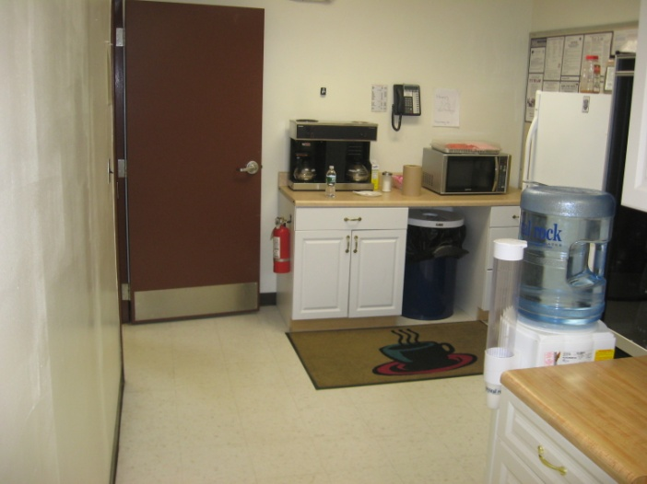
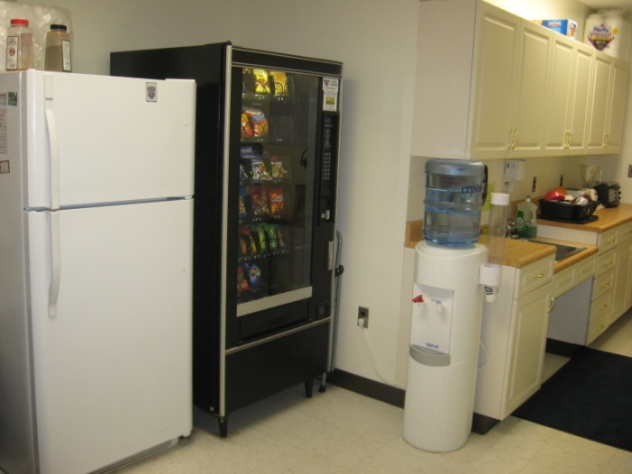
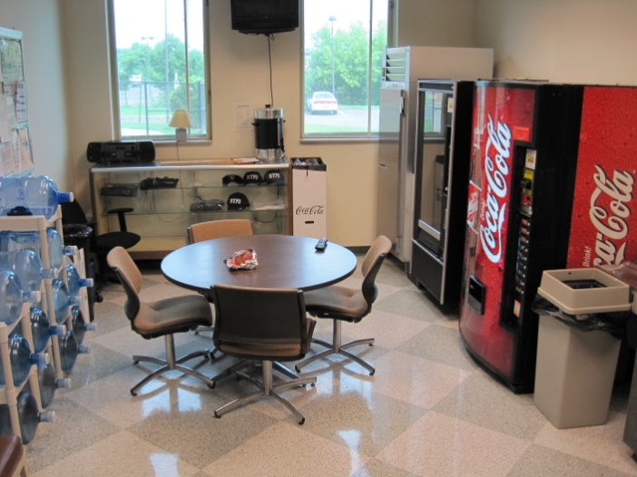
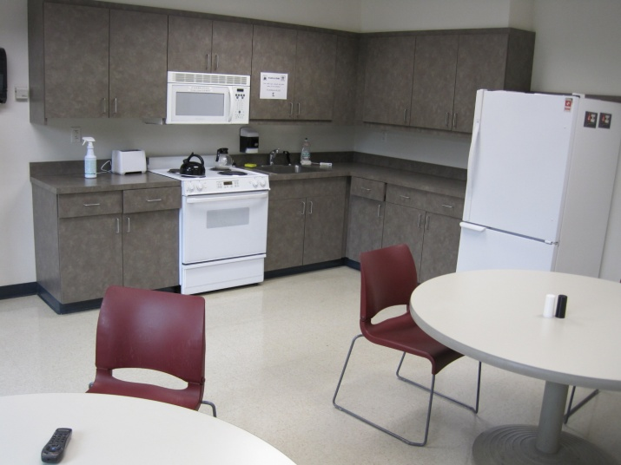
Day Room / Kitchen
Newtown PD
No tables, shared space.
Electrical deficiencies causing breaker failure/overload.
10’ x 5’ hallway
By Lieutenant David Kullgren
Wethersfield PD
Farmington PD

Slide 19
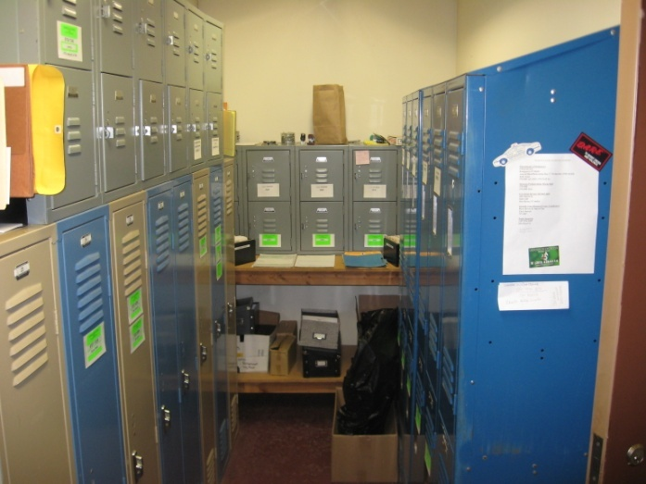
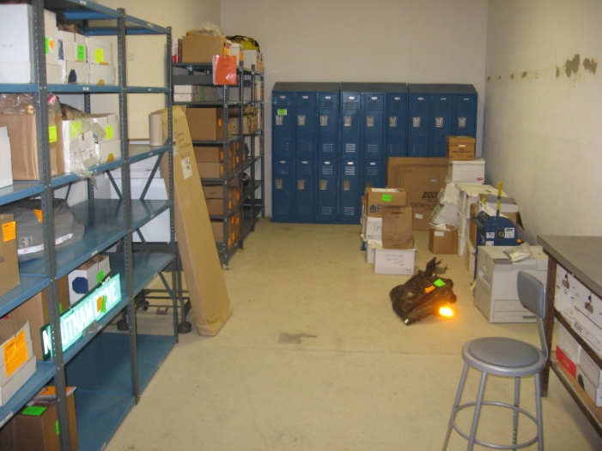
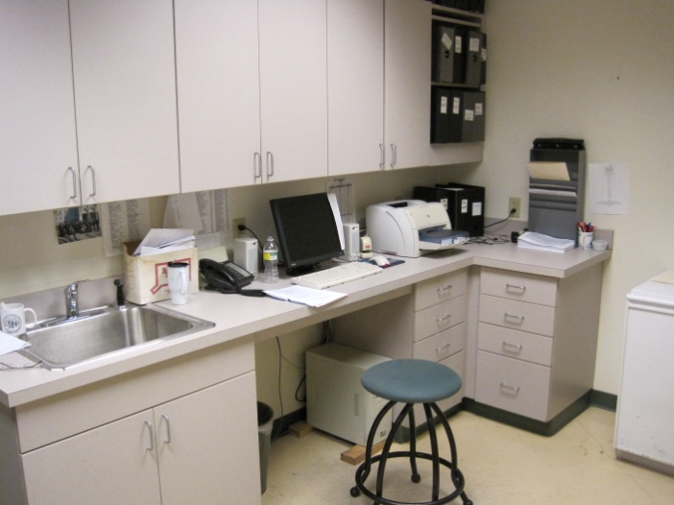
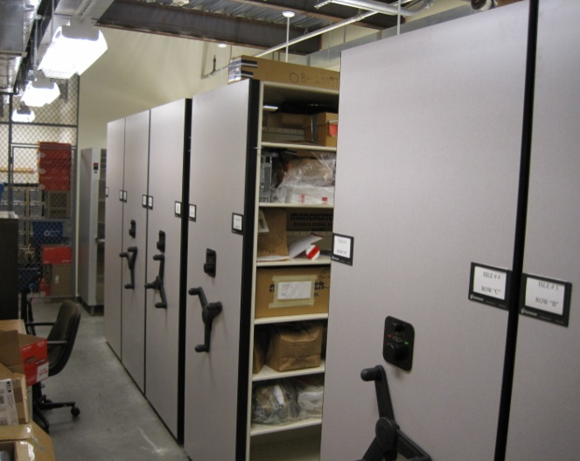
Evidence
Newtown PD
Currently we have two separate areas for evidence.
No evidence processing area.
Insufficient area for evidence storage to meet current standards.
7 1/2 ‘ x 10’ closet
14’ x 20’ room downstairs
Wethersfield PD
By Lieutenant David Kullgren

Slide 20
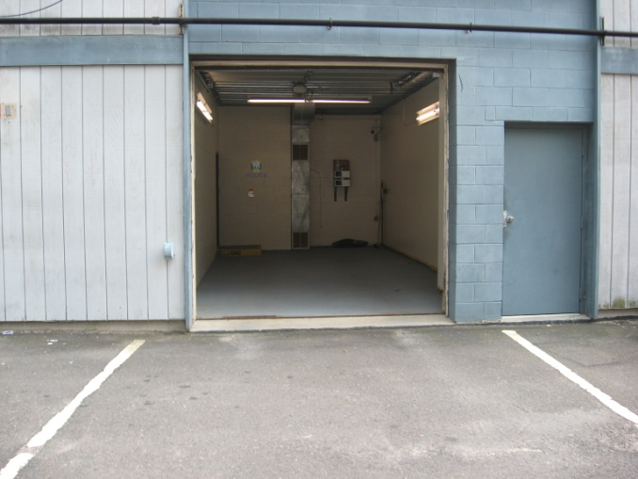
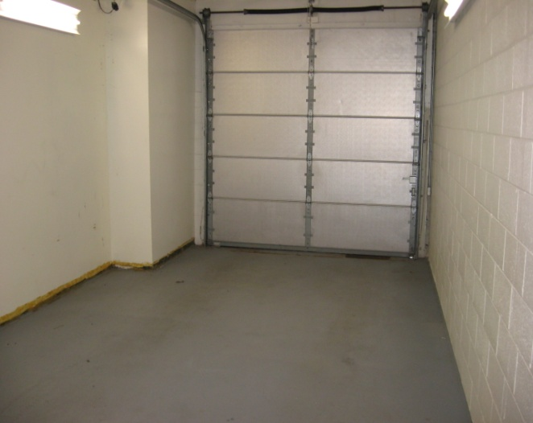
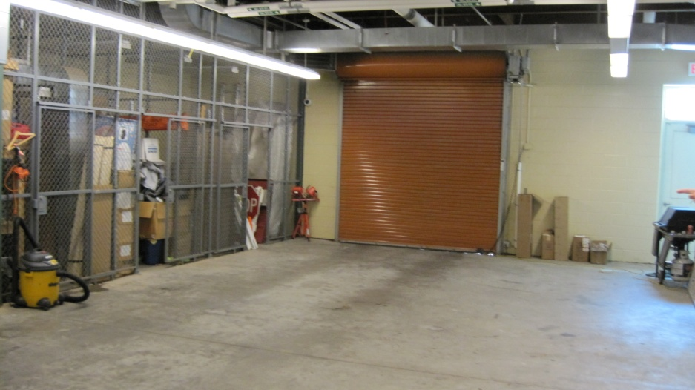
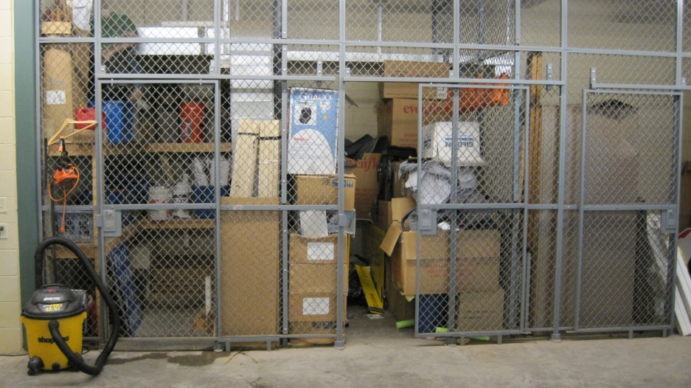
Sally Port
Only one secure door creating a security risk.
Processing of only one prisoner at one time.
Insufficient area to extract non compliant prisoners.
Minimal area for backing out of patrol vehicles.
12’ x 20’ garage
Newtown PD
Wethersfield PD
By Lieutenant David Kullgren

Slide 21
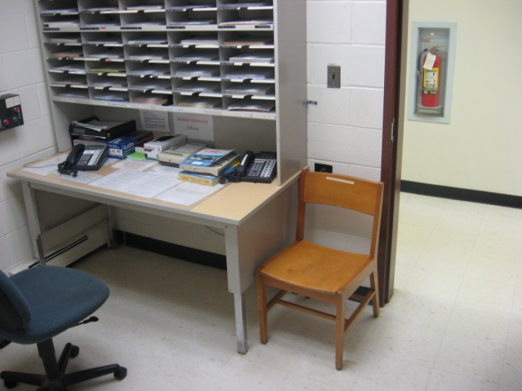
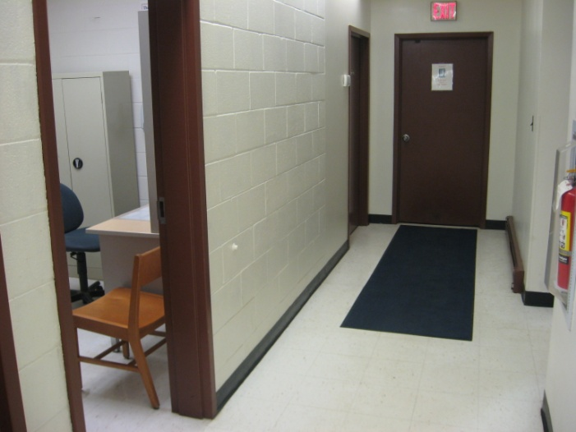
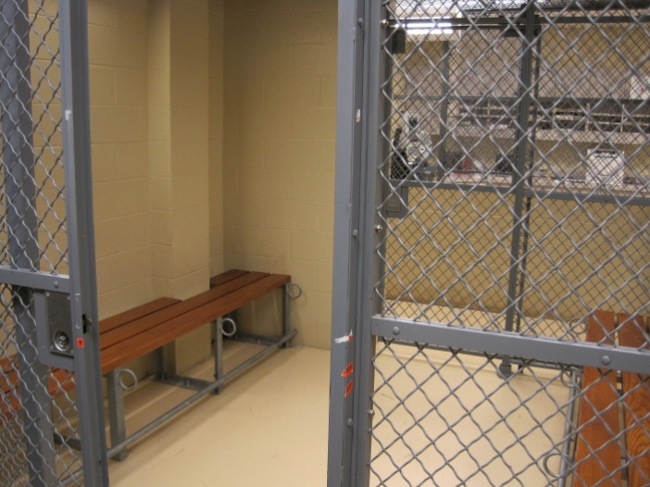
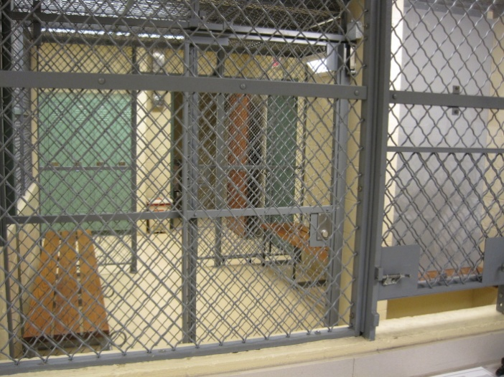
Prisoner Processing Area 1
Newtown PD
Small confined space, booking area separated from secondary processing and intox area.
No fire suppression system.
A 7 x 10’ room
Wethersfield PD
By Lieutenant David Kullgren

Slide 22
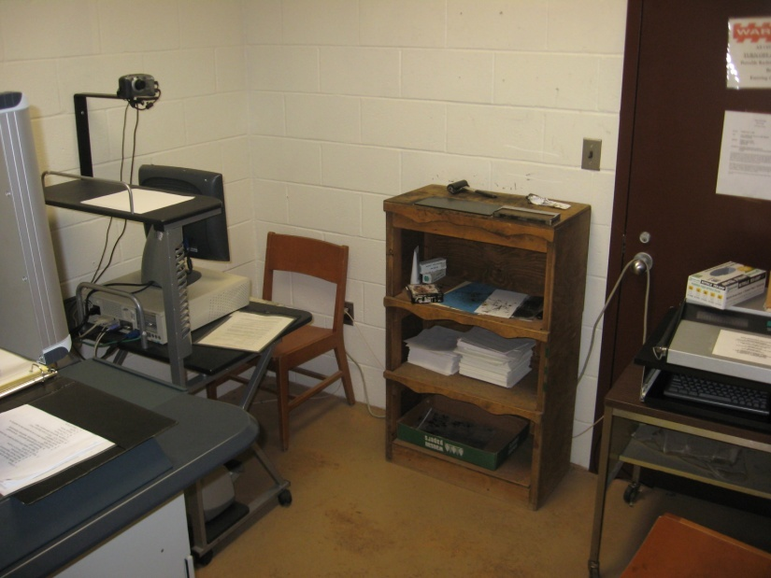
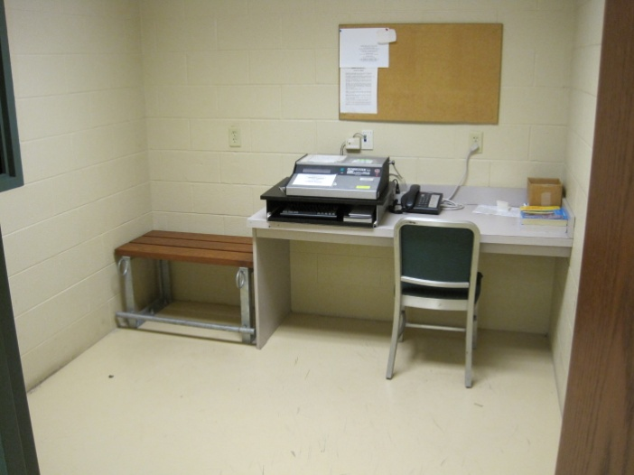
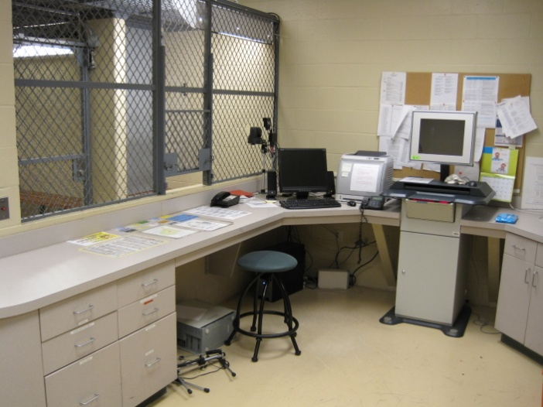
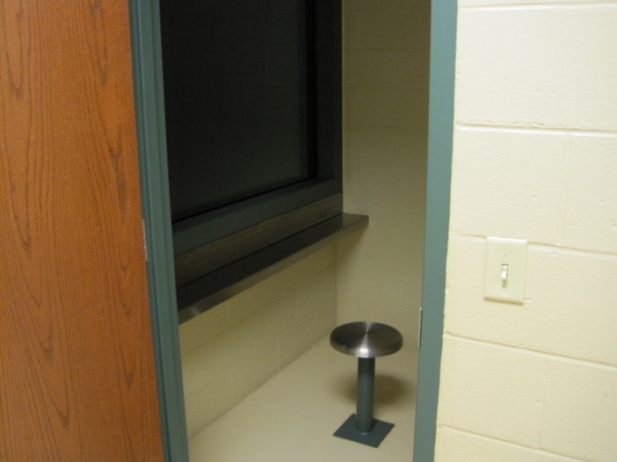
Prisoner Processing Area 2
Newtown PD
Two separate processing areas.
Cluttered environment creating officer safety concerns.
No visitor / attorney visiting area.
Unsecured furniture and equipment.
Indirect access to civilian employees.
7 1/2 ‘ x 10’ processing area.
Wethersfield PD

Slide 23
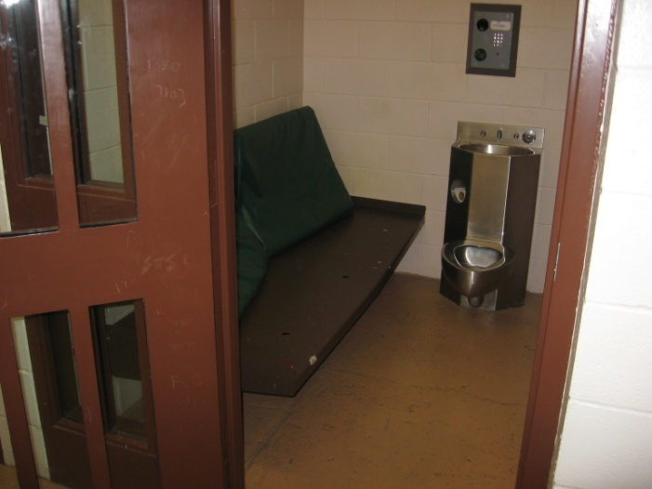
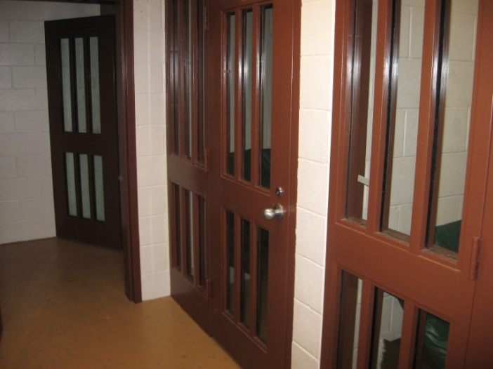
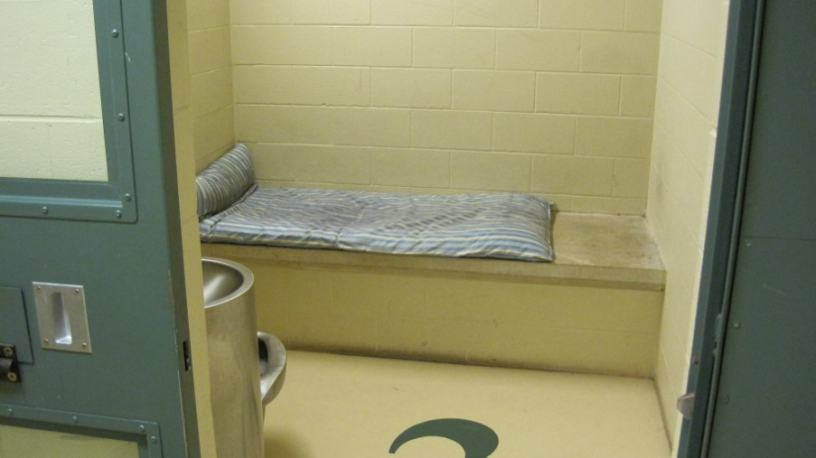

Cell Block
Cell area separate from booking with indirect access to civilian employees, roll call/training area, records.
Insufficient number of cells; male, female and juvenile (juvenile separation).
No fire suppression system.
Indirect access to civilian employees.
12’ x 19’ cells and hallway area
Newtown PD
Farmington PD
By Lieutenant David Kullgren

Slide 24



Sergeant Office
Newtown PD
Six patrol Sergeants share a 14’ x 14’ office.
Used to interview suspects, witnesses and victims.
Direct access to civilian employees.
Insufficient storage of patrol equipment.
File storage location.
Wethersfield PD
By Lieutenant David Kullgren

Slide 25



Administrative Work Area
Newtown PD
Insufficient file storage.
Lack of security with respect to sensitive files.
No public waiting area
Access not monitored.
16’ x 20’ open area and hallway
Wethersfield PD
By Lieutenant David Kullgren

Slide 26



Chief’s Office
Newtown PD
Small office area also used for file storage.
No conference area.
No visitor waiting area.
High volume traffic area.
15’ x 16’ room
Wethersfield PD
By Lieutenant David Kullgren

Slide 27


Lieutenant’s Office
Newtown PD
Wethersfield PD
Both Operational and Administrative Lieutenants share this office space.
No conference area.
High volume traffic area.
16’ x 16’ room shared by two Lt’s
File storage location
By Lieutenant David Kullgren

Slide 28

Captain’s Office
No conference area
No privacy
High volume traffic area
12 x 16 office
Newtown PD

Slide 29



Detective Bureau
Newtown PD
No conference / storage areas.
Insufficient supervisors office
Shared by 7 staff.
No interview rooms for detectives, SRO’s, Youth Officer
No confidentiality during sensitive investigations.
25’ x 14’ office includes closet and file storage.
Wethersfield PD

Slide 30




Locker Rooms
Insufficient lockers and storage. Two officers per locker.
Insufficient space for officers to change.
Insufficient showers
27’ x 18’ room; which house the lockers, toilet, urinals, shower and dressing area for 45 sworn officers.
Unsecured access
Newtown PD
Farmington PD
By Lieutenant David Kullgren

Slide 31


Storage
Newtown PD
Lack of sufficient storage areas
Common complaint even from newly built police departments is a lack of storage areas.
Erasure file storage area is already maxed out.
7’ x 20’ closet
Farmington PD
By Lieutenant David Kullgren

Slide 32




Impound Area
No proper storage for explosives
32’ x 47’ area
Current impound area also stores;
  Department equipment
  Command vehicle
  Maintenance items
  Auxiliary traffic equipment
  Found items
  Evidence
Newtown PD
Farmington PD
By Lieutenant David Kullgren

Slide 33


Armory
No preparation or cleaning area
Sheetrock walls
Insufficient space for all equipment and ammunition
No alarm or video monitoring
7’ x 12’ closet
Newtown PD
Farmington PD
By Lieutenant David Kullgren

Slide 34

Administrative Sgt’s Office
8’ x 12’ converted closet
Insufficient HVAC.
No conference area.
Newtown PD
By Lieutenant David Kullgren

Slide 35

Fitness Center
Currently there is no fitness center nor is there space for one.
Fitness Center
Wethersfield PD
By Lieutenant David Kullgren

Slide 36

Firearms Training
Just a few reasons to support a firing range
24/7 availability
Reduced liability, no need to borrow another departments range, scheduling conflicts.
Reduced overtime costs for travel and preparation.
Wethersfield PD
By Lieutenant David Kullgren

Slide 37
Conclusion & Recommendations
Keep the current CIP Plan as proposed.
Newtown is a growing community; economically, population and police activity.
Identify a Town parcel for the building site of the Newtown Police Department.
Public safety is one of the cornerstones to community development.
Projecting a professional image while remaining functionally efficient.
  Ambulance garage
  Newtown Hook & Ladder
  Sandy Hook Fire department, substation
Thank you,
James Viadero, Chief of Police

Slide 38
Inspiration
“Give us the tools and we will do the job”
- Winston Churchill
"We can't solve problems by using the same kind of thinking we used when we created them"
-Albert Einstein
By Lieutenant David Kullgren

Slide 39

Attachment A
2000 US Census Bureau

Slide 40

Attachment B
HC Planning Consultants 2008

Slide 41

Attachment C
HC Planning Consultants 2008

